Slide 1




NOIDA INSTITUTE OF ENGINEERING AND TECHNOLOGY, GREATER NOIDA
INTRODUCTION
UNIT: 1
Renewable Energy Resources (KOW – 074)
Presented By:
Mr. Vikas Kumar
Department of Mechanical Engg.
B.Tech: 7th Sem
1

Slide 2
FACULTY INTRODUCTION
Faculty Details:
Name of Faculty: Mr. Vikas Kumar
Higher Education : M.Tech (Mechanical Engineering)
Department: Department of Mechanical Engineering
Faculty Id: Vikaskumar.me@niet.co.in
Subjects: Fluid Mechanics & Machine
Applied Thermodynamics
Hybrid Vehicle Propulsion
Simulation , Modeling & Analysis
Basics of DBMS
2

Slide 3


CONTENTS
Energy and Development
Energy demand and availability
Energy crisis
Conventional and Nonconventional energy
Renewable and Non-renewable energy resources
Environmental impacts of conventional energy usage
Basic concepts of heat and fluid flow useful for energy systems

Slide 4
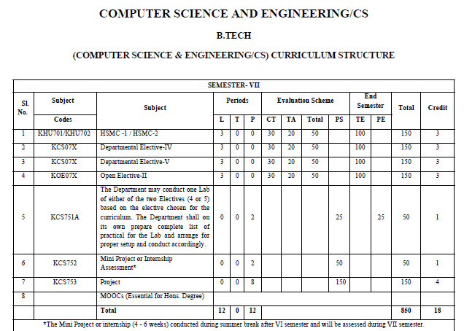
EVALUATION SCHEME

Slide 5
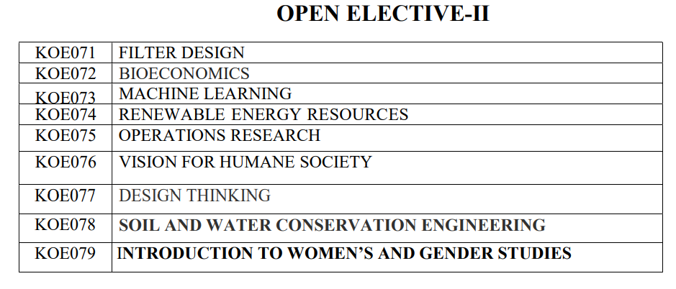
EVALUATION SCHEME

Slide 6













Course Objectives
.
To understand the need of energy conversion and the various renewable energy resources
CO 1
To impart the knowledge of solar energy and apply different method of solar energy
CO 2
To impart the knowledge of hydro power and utilize it on small scale.
CO 3
To Explain bio gas generation and its impact on environment
CO 4
To apply Winds energy as alternate form of energy and to know how it can be trapped
CO 5

Slide 7

CO-PO and PSO Mapping
CO | PO1 | PO2 | PO3 | PO4 | PO5 | PO6 | PO7 | PO8 | PO9 | PO10 | PO11 | PO12 | PSO1 | PSO2 | PSO3
AMTME0113.1 | 3 | 3 | 2 | 2 | - | - | 2 | - | 2 | - | - | 3 | 3 | 2 | 3
AMTME0113.2 | 3 | 3 | 2 | 2 | - | 2 | 2 | - | 2 | 2 | - | 3 | 3 | 3 | 3
AMTME0113.3 | 3 | 3 | 2 | - | 2 | 3 | 3 | 2 | 2 | 2 | - | 3 | 2 | 3 | 3
AMTME0113.4 | 3 | 3 | 2 | 3 | 2 | 2 | 2 | 2 | 2 | - | - | 3 | 3 | 3 | 3
AMTME0113.5 | 2 | 2 | 2 | - | 2 | - | 3 | - | 2 | 2 | - | 3 | 3 | 3 | 3
Avg | 3 | 3 | 2 | 2 | 1 | 2 | 2 | 1 | 2 | 1 | - | 3 | 2.67 | 3 | 3

Slide 8
Syllabus
Unit-I: Introduction: Various non-conventional energy resources- Introduction, availability, classification, relative merits and demerits. Solar Cells: Theory of solar cells. Solar cell materials, solar cell array, solar cell power plant, limitations.
Unit-II: Solar Thermal Energy: Solar radiation, flat plate collectors and their materials, applications and performance, focusing of collectors and their materials, applications and performance; solar thermal power plants, thermal energy storage for solar heating and cooling, limitations.
CO1

Slide 9
Syllabus
Unit-III: Geothermal Energy: Resources of geothermal energy, thermodynamics of geo- thermal energy conversion-electrical conversion, non-electrical conversion, environmental considerations. Magneto-hydrodynamics (MHD): Principle of working of MHD Power plant, performance and limitations. Cells: Principle of working of various types of fuel cells and their working, performance and limitations.
CO1

Slide 10
Syllabus
Unit-IV: Thermo-electrical and thermionic Conversions: Principle of working, performance and limitations. Wind Energy: Wind power and its sources, site selection, criterion, momentum theory, classification of rotors, concentrations and augments, wind characteristics. Performance and limitations of energy conversion systems.
Unit-V: Bio-mass: Availability of bio-mass and its conversion theory. Ocean Thermal Energy Conversion (OTEC): Availability, theory and working principle, performance and limitations. Wave and Tidal Wave: Principle of working, performance and limitations. Waste Recycling Plants.
CO1

Slide 11
COURSE APPLICATION
Application of Renewable Energy System:
Renewable Energy
Type | Application
Solar | Household Appliance, Water Heating
Biomass | Heat Energy
Wind | Power Generation
Biogas | Cooking

Slide 12



Unit Objective
To understand the different types of energy resources and need of various renewable energy resources.
UNIT OBJECTIVE

Slide 13
Course Outcomes
Understand and utilize different renewable sources of energy
CO1
Utilize the knowledge of solar energy and apply different method of solar energy
CO2
Understand the procedure and application of micro and small hydro energy system.
CO3
Utilize bio mass energy and understand the process of bio gas generation
CO4
Understand the advantage and disadvantage of Wind energy.
CO5

Slide 14


Objective of Topic
Topic: Introduction of renewable energy system
Objective of Topic: To explain different types of energy resources and explain renewable energy system

Slide 15
PREREQUISITE AND RECAP
Topic: Introduction
Prerequisite : Basic of energy

Slide 16
What is Energy (CO1)
Energy is the quantitative property that must be transferred to an object in order to perform work on the object.
Energy is the capacity of a physical system to perform work. Energy exists in several forms such as heat, kinetic or mechanical energy, light, potential energy, electrical or other forms.
The Sun is the source of energy for most of life on Earth.
The fact that energy can be neither created nor be destroyed is called the law of conservation of energy.
In the form of the first law of thermodynamics, this states that a closed system's energy is constant unless energy is transferred in or out by work or heat, and that no energy is lost in transfer.
.

Slide 17
What is Energy (cont…)
It is a ‘capacity to do work’
In modern era people depend upon energy and Fossil fuel like coal, oil & natural gas are main source of energy
Energy can be classified into several types based on the following criteria:
Primary and Secondary energy
Commercial and Non commercial energy
Renewable and Non-Renewable energy
.

Slide 18
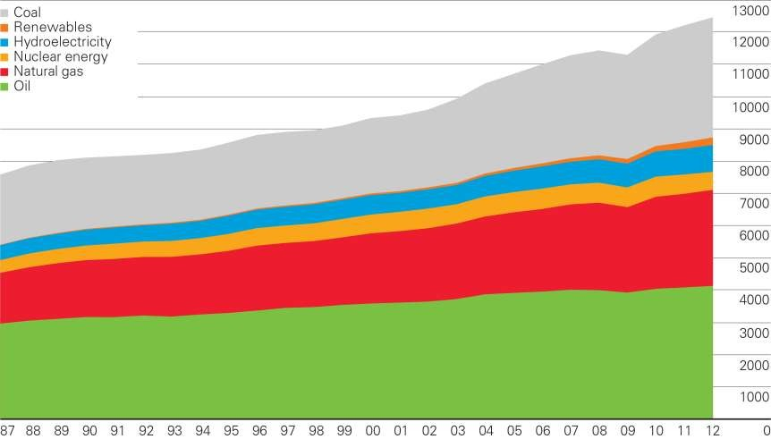
Primary Energy World Consumption (CO1)

Slide 19
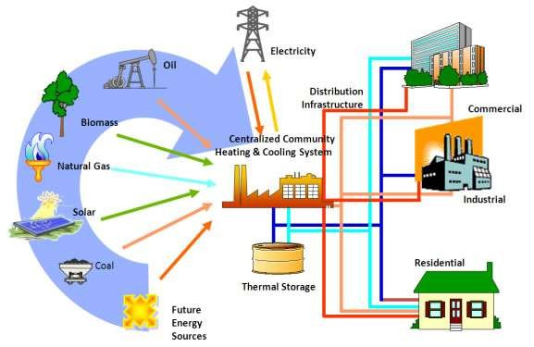

Role of Energy (CO1)
Driver of Growth
Critical infrastructure for development
Prime mover of development
Transport

Slide 20
World Energy Consumption (CO1)
There is uneven pattern of energy consumption in different country
Developed country have a population of 10%, use approx. 90% of the available resources
One the other side, there is country where people depend on wood as a form of energy
From last 20 year developing country focus on energy sector
Rate of growth in energy sector in developed country is 1% to 2%, but in developing country growth rate is 7 to 8%.

Slide 21
World Energy Consumption (cont…)
Per Capita Energy Consumption (kWh)
United Arab Emirates
Sweden
USA
Australia
Japan Germany
China
Indonesia
India
9389
14030
13246
10720
7848
Per Capita Energy Consumption (kWh)
7081
3298
680
684
0
5000
10000 15000

Slide 22







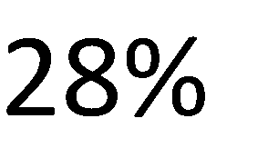
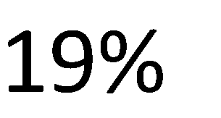









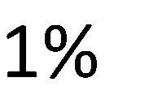







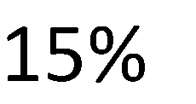


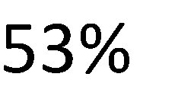


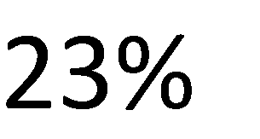
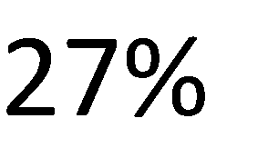
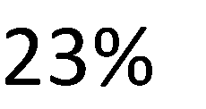

World energy usage (CO1)

Slide 23
Energy and Development (CO1)
Energy consumption and Development seem to be closely linked
Development is not possible without energy usage
In agriculture sector; tube well, tractor machine etc. requires energy
In manufacturing sector; energy is require for running machines
Important to find cleaner source of energy to save ourselves

Slide 24



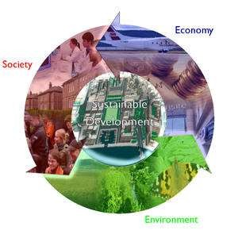






Growth, Development and Energy (CO1)
Economic growth is the increase in the market value of the goods and services produced by an economy over time. It is conventionally measured as the percent rate of increase in real gross domestic product, GDP.
.
Economic
development
implies
changes in
income, savings and
investment along with progressive changes in socio-economic structure of country (institutional and technological changes).

Slide 25
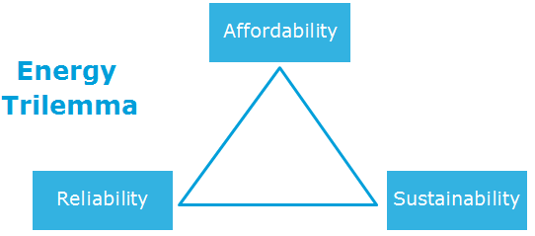
Sustainable Development (CO1)
“Development that meets the needs of the present without compromising the ability of future generations to meet their own needs”
.

Slide 26
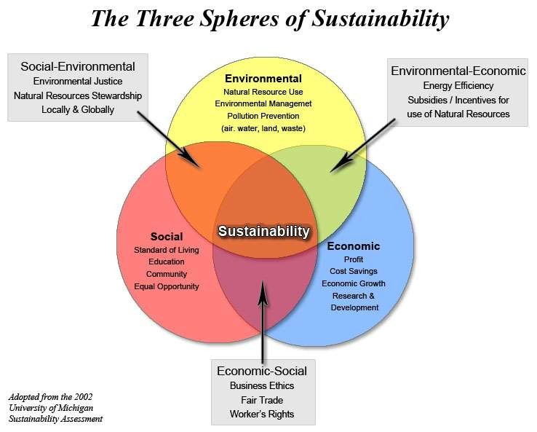
The Three Spheres of Sustainability(CO1)
.

Slide 27
Energy and Economics (CO1)
Energy is essential for Economic growth
Economics growth is essential for country like India
Ratio of energy demand and GDP is useful indicator for Economics growth
Per Capita Energy Consumption of USA 13246 kwh/Year
India Per capita consumption is about 684kwh/Year
Economic growth of country is depend upon rate of improvement in per capita energy consumption

Slide 28
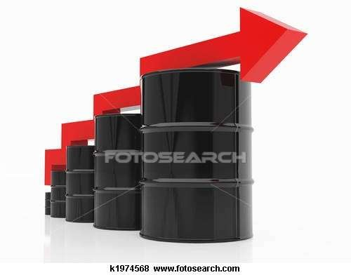
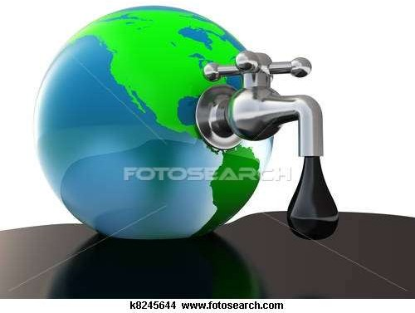
Energy crisis (CO1)
An energy crisis is any great bottleneck (or price rise) in the supply of energy resources to an economy.
The supply of energy is far less than its demands can effect the whole mankind to run towards the development or daily purposes that crisis is called energy crisis
DEMANDS IN ENERGY INCREASING
LACK OF ENERGY

Slide 29




Energy crisis (cont…)
Oil crisis
petroleum
crisis
electricity shortage or electricity crisis.
energy
shortage

Slide 30
Causes of energy crisis(CO1)
Oil Shortage: Reserves of mineral oil in India is only 0.3% of world’s known oil reserves. Oil shortage adversely effect the transport sector in the economy. Again rising oil prices has led to rising general prices in India.
Coal shortage: Coal reserves are quantitatively and qualitatively poor. Coal shortages adversely affects generation of electricity, therefore, restricts the economic development.
Power shortage: A severe shortage exists in generation and distribution of electric power in India. Power shortage affects. industrial as well as agricultural production seriously.
Population Growth: The increased population desires more products to use, results in using more energy to make those products in order to provide more infrastructures.

Slide 31
Need to reform in Energy sector (CO1)
Developing countries require substantial investments in their power sectors to sustain economic growth and reduce poverty
Fossil fuels are depleted and need proper care
Global pollution level increase and there is threat of global warming
Oil & gas crisis in 1980
Kyoto Protocol sign by country to reduce carbon emission
Control Oil war (developed country pressurized oil rich country)

Slide 32
Energy scenario in India (CO1)
By 2016-2017, total domestic energy production of 670 million tons of oil equivalent (MTOE). This meet only 71% of the expected demand.
As per the 2011 Census, 55.3% rural households had access to electricity
Still most of the rural area have limited supply hours of electricity
India ready to exploit renewable energy resources

Slide 33
Conventional Energy Sources (CO1)
Conventional energy sources are the traditional sources of energy like coal and petroleum. Conventional energy sources are finite. They will not last forever.
Coal, oil and natural gas are the major source of energy from longtime
Still 80% energy requirement is fulfill by fossil fuel
Coal play a major role to run thermal power plant
Due to rapid industrialization, consumption increase Manifold
Oil and gas decide the economic condition of country
These resources are limited and must be conserve
Main cause of air pollution and global warming

Slide 34
Types of conventional energy resources (CO1)
Natural Gas- Natural gas in its purest form is pure methane but before it is refined, it also contains varying amount of ethane, propane, butane and carbon dioxide. When refined, it is colorless and odorless but can be burned to release large amounts of energy.
Coal- Coal releases large amounts of energy when it is burned because of the density of hydrocarbons in the material. Coal is formed by dead plants being put under significant pressure and temperature for millions of years. There are four grades of coal: lignite, subbituminous, bituminous coal and anthracite. Bituminous coal is the best for releasing energy and is the most commonly mined type of coal .
Petroleum- Petroleum is formed from the compression of animal and plant remains over millions of years. Petroleum has to be drilled for because it is usually located deep below the earth's surface and is then refined to produce a number of different products including gasoline, heavy fuel oil and diesel fuel.
11

Slide 35
Advantages of Conventional Energy Sources
Conventional energy sources are proven technologies which can provide energy regardless of the weather conditions unlike solar and wind power which may go for days without being able to produce substantial amounts of power.
Currently, the financial costs are much lower than alternative energy sources

Slide 36
Disadvantages of Conventional Energy (CO1)
Petroleum, gas and coal are non renewable energy sources which means that they will eventually run out.
These energy sources also release greenhouse gases like carbon dioxide into the atmosphere which contribute to global warming.
Other pollutants released include sulfur and nitrogen oxide, which can lead to acid rain and mercury, which is harmful to humans when ingested.

Slide 37
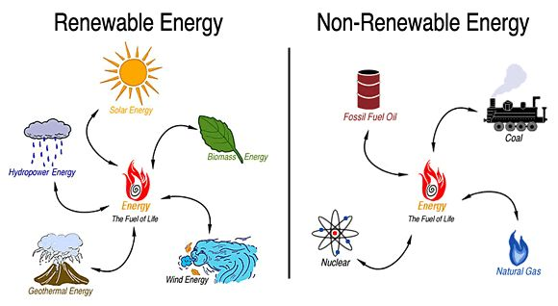
Compare Energy(CO1)

Slide 38
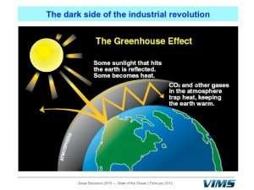
Environmental impact of Energy Usage (CO1)
Climate Change
Global Warming
Ozone layer Depletion
Rise in Sea Levels
Changes in amount and pattern of precipitation
Extreme weather
Glacier Retreats
Biological Extinction
Health Hazards
Agriculture distortions

Slide 39
Green house effect (CO1)
Green house gases make the Earth warmer by trapping energy in the atmosphere.
Green house gases –carbon dioxide, nitrous oxide, methane, chloro-fluorocarbons.
Green house gases are the temperature stabilizers of the earth’s atmosphere.
Temperature stabilization is by trapping radiated heat from the earth’s surface by these green house gases.

Slide 40
How to reduce Greenhouse Effect (cont…)
Using Renewable Energy
Plant a Tree
Transportation
Reduce, Reuse and Recycle
learn to conserve … and many more.

Slide 41
Climate change (CO1)
Climate is the long-term average of a region's weather.
For example, it's possible that a winter day in Bangalore could be sunny and mild, but the average weather –the climate –tells us that Bangalore's winters will mainly be cold and include rain.
Climate change represents a change in these long-term weather patterns. They can become warmer or colder. Annual amounts of rainfall or snowfall can increase or decrease.

Slide 42
Climate Change Prevention (CO1)
Improving the energy efficiency to reduce emissions from heating/cooling.
Planting forests and tree to remove excess carbon dioxide from our atmosphere.
Reducing fuel emissions associated with motor vehicles

Slide 43
Global warming(CO1)
Due to emissions from the fossil fuel based systems, the green house gases in the atmosphere increases.
As a result, the average temperature of the earth is becoming higher.
Global warming refers to an average increase in the Earth's temperature, which in turn causes changes in climate. A warmer Earth may lead to changes in rainfall patterns, a rise in sea level, and a wide range of impacts on plants, wildlife, and humans.

Slide 44
Global Warming Prevention (cont..)
Recycle more. The aim is to cut down the amount of carbon dioxide released in the environment.
Drive less
Plant trees.
Switch to renewable energy.
Use energy-efficient devices.
Spread awareness.

Slide 45
Ozone Layer Depletion (cont..)
It is a shield protecting us from solar radiation.
When the radiation reaches the ozone layer, it passes through the ozone molecules and these are responsible for returning part of radiation back to space, in this way the radiation that reaches us is minimized.
Also protect us from Sun’s harmful ultraviolet rays.

Slide 46
Ozone Layer Depletion Prevention(cont..)
Avoid the consumption of gases dangerous to the ozone layer
Minimize the use of cars
Do not use cleaning products that are harmful to the environment and to us
Buy local products
Maintain air conditioners

Slide 47
Renewable Energy Sources (CO1)
Non-conventional sources of energy are the energy sources which are continuously replenished by natural processes.
These cannot be exhausted easily, can be generated constantly so can be used again and again, e.g. solar energy, wind energy, tidal energy, biomass energy and geothermal energy etc.
The energy obtained from non-conventional sources is known as non-conventional energy.
These sources do not pollute the environment and they are called renewable resources as they can be replaced through natural processes at a rate equal to or greater than the rate at which they are consumed.

Slide 48
Renewable Energy Sources (CO1)
Renewable energy is natural energy which does not have a limited supply. Renewable energy can be used again and again, and will never run out.
Renewable energy is energy which comes from natural resources such as sunlight, wind, rain, tides and geothermal heat, which are renewable (naturally replenished.)
Renewable energy is an alternative to fossil fuels and nuclear power, and was commonly called alternative energy.
Renewable energy replaces conventional fuels in four distinct areas:
power generation,
hot water/ space heating,
transport fuels and
rural (off-grid) energy services.

Slide 49
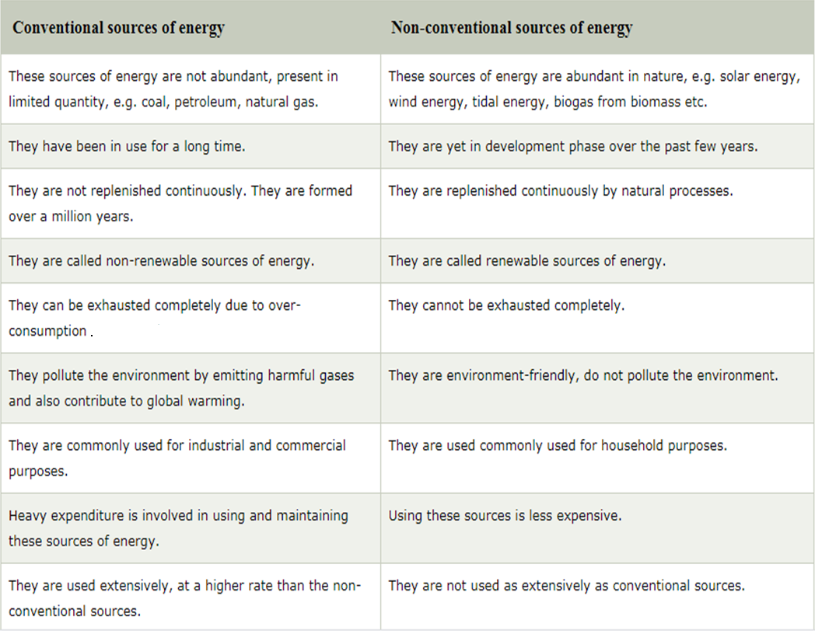
Conventional vs. Non-conventional energy
.

Slide 50
Advantages of renewable energy sources (CO1)
Renewable energy sources consist of solar, hydro, wind, geothermal, ocean and biomass. The most common advantage of each is that they are renewable and cannot be depleted.
They are clean energy, as they don't pollute the air, and they don't contribute to global warming or greenhouse effects.
Since their sources are natural the cost of operations is reduced and they also require less maintenance on their plants.
They require little maintenance.
They are a long-term cost-effective choice

Slide 51
Disadvantages of Renewable energy sources
A common disadvantage to all is that it is difficult to produce the large quantities of electricity their counterpart the fossil fuels are able to.
Since they are also new technologies, the cost of setup is high.
Wind : turbines are expensive. Wind doesn't blow all the time, so they have to be part of a larger plan.
Solar : panels are expensive. Not all climates are suitable for solar panels.
Energy cannot be taken 24/7, year-round, because certain days will be windier than others, and the sun will shine. stronger on other days.
Energy must be stored. Geographical locations might be difficult to navigate.

Slide 52
Disadvantages of Renewable energy sources
Tides : barrages (dams) across river mouths are expensive to build and disrupt shipping. Smaller turbines are cheaper and easier to install.
Rivers : Dams are expensive to build and disrupt the environment. They have also caused earthquakes.
Geothermal : Difficult to drill two or three kilometres down into the earth.
Biofuel : Often uses crop lands and crops (like corn) to produce the bio-alcohol. This means that more land has to be cleared to grow crops, or there is not enough food, or that food becomes more expensive.

Slide 53
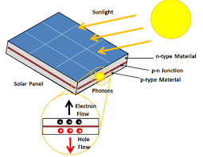
Solar Cells
Solar cells (Photovoltaic Cells), convert the energy of light into electrical energy using the photovoltaic effect.

Slide 54
Solar Cells
A solar cell is a device that converts incident light into electric energy by photovoltaic effect.
Photovoltaic effect was first demonstrated in 1839 by French scientist Edmond Becquerel.
Later, in 1883, Charles Fritts fabricated the first photovoltaic cell by making a thin film gold electrode on a selenium semiconductor.
The beginning of the 20th century opened a new paradigm of solar-energy harvesting when Einstein proposed his quantum interpretation of the photoelectric effect.
After the discovery of the p-n junction in 1941, the first photovoltaic cell was invented in Bell laboratories.

Slide 55
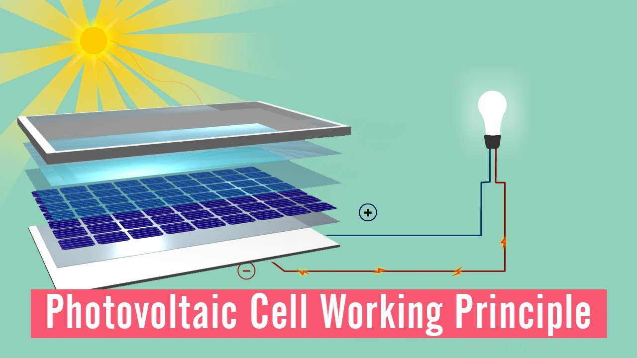
Solar Cells
Sunlight shines on the surface of the cell
Energy is carried through the layers of the cell as photons
The photons give their energy over to electrons in the lower layer
The electrons use this energy to jump back into the upper layer and escape into the circuit
The electrons flowing around the circuit provide the power to a device

Slide 56
Generation of Solar Cells
First-generation solar cells:
These are based on the most effective and commercially viable silicon. Today, 80% of solar cell production is based on silicon-based solar cells of the first generation. For example: solar cells of monocrystalline, polycrystalline, amorphous, and hybrid silicon.
Monocrystalline silicon solar cells:
These are made by single crystal of silicon that is grown under extremely controlled conditions.
These solar panels can deliver photoconversion efficiency of 24%.
But their production cost and poor performance at elevated temperatures are the major issues.

Slide 57
Generation of Solar Cells
Polycrystalline silicon solar cells:
These are developed by growing different interlocking crystals of silicon, which makes it cheaper compared to monocrystalline. However, photoconversion efficiency is sacrificed over the preparation cost.
Amorphous silicon solar cells:
These are used to harvest energy on a small scale, such as for portable and self-powered electronic devices.
A thin film of silicon is deposited on metallic, glass, or plastic substrates. Due to the thin film, this solar cell is highly flexible,
Its efficiency is much less (10%) and it does not work at low-light intensities.

Slide 58
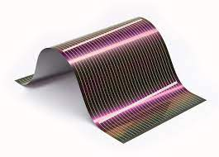
Generation of Solar Cells
Second-generation solar cell:
These are thin film based solar cells. The structure of the solar cell is layered, and the amount of material used is much less compared to the crystalline silicon solar cells.
Additionally, the fabrication cost is also much less, which leads highly economical production of solar cells.

Slide 59
Generation of Solar Cells
These solar cells include amorphous solar cells and two non-silicon-based solar cells (cadmium telluride and copper indium gallium diselenide).
The maximum efficiency recorded for a thin film solar cell was 24.7%. However, the use of cadmium is a serious environmental concern.

Slide 60
Solar Cells
Smaller groups of cells are called solar cell panels or, more commonly, solar panels. The different types of solar panels have a variety of uses, from being placed on rooftops to replace or supplement a domestic electricity supply or to provide electric power to locations where conventional sources are unavailable or expensive to install. Due to the lack of moving parts or fuels, solar panels are also widely used in space, including for satellites and space stations, although diffusion of the Sun’s energy in the further parts of the solar system mean that these panels cannot be used to send probes out to interstellar space.
On the smallest level, solar cells are used in many consumer products, including toys, calculators and radios. These solar cells can also use artificial light as well as sunlight for power.

Slide 61
Solar Collectors(CO2)
.
Solar collectors transform solar radiation into heat and transfer that heat to a medium (water, solar fluid, or air).
Then solar heat can be used for heating water, to back up heating systems or for heating swimming pools
A solar collector is basically a flat box and are composed of three main parts, a transparent cover, tubes which carry a coolant and an insulated back plate.
The solar collector works on the green house effect principle; solar radiation incident upon the transparent surface of the solar collector is transmitted through though this surface.
The inside of the solar collector is usually evacuated, the energy contained within the solar collect is basically trapped and thus heats the coolant contained within the tubes.
The tubes are usually made from copper, and the back plate is painted black to help absorb solar radiation.
The solar collector is usually insulated to avoid heat losses.

Slide 62
Types of collectors(CO2)
• Stationary
• Sun tracking Applications
• Solar water heating
• Solar space heating and cooling
• Refrigeration
• Industrial process heat
• Solar thermal power systems

Slide 63
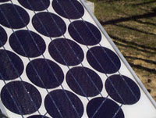
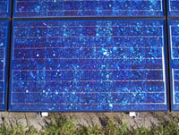
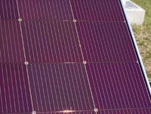
Commercial Solar Cells(CO2)
.
Single crystal silicon
Poly-Crystal Silicon
Thin Films

Slide 64
Solar Cells
1. Crystalline Silicon Cells
Around 90% of solar cells are made from crystalline silicon (c-Si) wafers which are sliced from large ingots grown in laboratories. These ingots take up to a month to grow and can take the form of single or multiple crystals. Single crystals are used to create monocrystalline solar panels and cells (mono-Si), while multiple crystals are used for polycrystalline panels and cells (multi-Si or poly c-Si).
These solar cells use an n-type ingot, which are made by heating silicon chunks with small amounts of phosphorus, antimony or arsenic as the dopant. The n-type ingot is coupled with a p-type silicon layer, which uses boron as the dopant. The n-type and p-type ingots are fused to create a junction in a process that was first devised in 1954.
Monocrystalline cells have a distinctive appearance and are often coloured as well as tending to have a cylindrical shape. These cells are cut into shape, which can be wasteful, but do provide the highest levels of efficiency. Polycrystalline cells do not need to be cut to shape as the silicon is melted and poured into square moulds. Polycrystalline solar panels are seen as being a mid-range option both in terms of price and efficiency.

Slide 65
Solar Cells
2. Thin Film Solar Cells
Crystalline silicon cells are made from wafers that are just a fraction of a millimetre deep (around 200 micrometers, 200μm), however thin-film solar cells, also called thin-film photovoltaics are around 100 times thinner. These thin film solar panels and cells are made from amorphous silicon (a-Si), in which the atoms are randomly arranged rather than in an ordered crystalline structure. These films can also be made from cadmium-telluride (Cd-Te), copper indium gallium diselenide (CIGS) or organic PV materials.
These cells are produced by layering photovoltaics to create a module and are the cheapest option for producing solar panels. The cells can be laminated onto windows, skylights, roofing tiles and other substrates, including glass, metals and polymers. However, despite this flexibility, they are not as efficient as regular crystalline silicon cells. Where crystalline silicon cells can produce a 20% efficiency, these thin film cells only reach around 7% efficiency. Even the very best CIGS cells barely reach 12% efficiency.

Slide 66
Solar Cells
3. Third Generation Solar Cells
The latest solar cell technologies combine the best features of crystalline silicon and thin-film solar cells to provide high efficiency and improved practicality for use. They tend to made from amorphous silicon, organic polymers or perovskite crystals, and feature multiple junctions made up from layers of different semiconducting materials.
These cells have the potential to be cheaper, more efficient and more practical than other types of cell, and have been shown to be able to achieve around 30% efficiency (with a perovskite-silicon tandem solar cell).

Slide 67
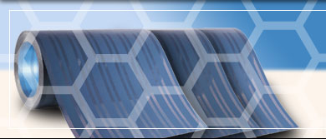
Emerging technologies in solar system(CO2)
Nano-solar techniques
NanoSolar – Electrically Conductive Plastics
Konarka – Polymer and dye-sensitized solar cell have flexible cells about 5 % efficient
.

Slide 68
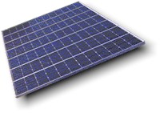
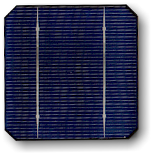

Cells, Modules and Arrays(CO2)
.

Slide 69
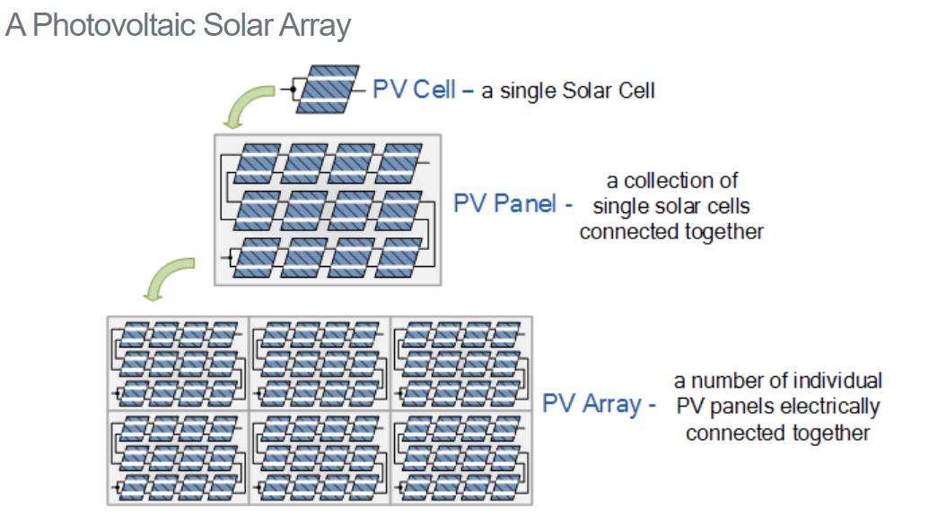
Cells, Modules and Arrays(CO2)
.

Slide 70
Cells, Modules and Arrays(CO2)
Solar Array is a system made up of a group of solar panels connected together.
A photovoltaic array is therefore multiple solar panels electrically wired together to form a much larger PV installation (PV system) called an array.
A complete photovoltaic system uses a photovoltaic array as the main source for the generation of the electrical power supply.
Most manufactures produce a standard photovoltaic panel with an output voltage of 12V or 24V.
By connecting many single PV panels in series (for a higher voltage requirement) and in parallel (for a higher current requirement) the PV array will produce the desired power output.

Slide 71
Cells, Modules and Arrays(CO2)
Solar Array Parameters
Open Circuit Voltage (V_{OC} ): This is the maximum voltage that the array provides when the terminals are not connected to any load (an open circuit condition). This value is much higher than Vmax which relates to the operation of the PV array which is fixed by the load. This value depends upon the number of PV panels connected together in series.
Short Circuit Current( I_{SC} ): The maximum current provided by the PV array when the output connectors are shorted together (a short circuit condition). This value is much higher than Imax which relates to the normal operating circuit current.
Maximum Power Point (P_{max} ): This relates to the point where the power supplied by the array that is connected to the load (batteries, inverters) is at its maximum value, where Pmax = Imax x Vmax. The maximum power point of a photovoltaic array is measured in Watts (W) or peak Watts (Wp).

Slide 72
Cells, Modules and Arrays(CO2)
Fill Factor (FF): The fill factor is the relationship between the maximum power that the array can actually provide under normal operating conditions and the product of the open-circuit voltage times the short-circuit current, ( Voc x Isc ) This fill factor value gives an idea of the quality of the array and the closer the fill factor is to 1 (unity), the more power the array can provide. Typical values are between 0.7 and 0.8.
Percent Efficiency (% eff) : The efficiency of a photovoltaic array is the ratio between the maximum electrical power that the array can produce compared to the amount of solar irradiance hitting the array. The efficiency of a typical solar array is normally low at around 10-12%, depending on the type of cells (monocrystalline, polycrystalline, amorphous or thin film) being used.

Slide 73

VIDEO LINKS AND ONLINE COURSES DETAILS
Youtube /other Video Links
https://www.youtube.com/watch?v=T4xKThjcKaE
https://www.youtube.com/watch?v=eiBiB4DaYOM
https://www.youtube.com/watch?v=A9Z8Ro4Z5b8
48

Slide 74



DAILY QUIZ
1. Which is not a renewable energy source?
Coal
Sunlight
Water
Wind
2. Energy that comes from heat below the Earth's surface is called ______.
geothermal energy
hydropower
solar energy
biomass energy

Slide 75
DAILY QUIZ
3. Which is true of renewable energy sources?
They include solar energy and geothermal energy.
They can never run out.
They are always being replenished.
All answers are correct.
4. Do renewable energy sources run out?
Yes
no

Slide 76
DAILY QUIZ
5. __________ is an energy resource that WILL run out in the next several hundred years.
Renewable Energy Resource
Nonrenewable Energy Resource
Fossil Fuels
Forever Fuels
6. Coal is a __________ energy resource.
Renewable
Non renewable

Slide 77
GLOSSARY QUESTIONS
Kindly choose answer from following Glossary:
Primary source of Energy
Secondary source of Energy
None
QUESTIONS
Q. 01. Wind is,
Q. 02 Coal is,
Q. 03. Solar is,

Slide 78
WEEKLY ASSIGNMENT
What is renewable energy?
What are the main determinants of the development of renewable energy sources?
What are the some different sources of energy that human use?
What are the advantage and disadvantage of renewable energy sources?
How many types of renewable energy resources are there?
Why is renewable energy use growing?

Slide 79

MCQ
1-Which of the following is (are) renewable resource(s)
(A) wind
(B) tides
(C) geothermal heat
(D) all of the above
2-Which of the following country generate all their electricity using renewable energy?
(A) Iceland
(B) England
(C) USA
(D) China
3-Renwable energy often displaces conventional fuel in which of the following area
(A) space heating
(B) transportation
(C) electricity generation
(D) all of the above

Slide 80
MCQ
4-Biodiesel is produced from oils or fats using
(A) fermentation
(B) trans esterification
(C) distillation
(D) none of the above
5- Photovoltaic cell converts solar energy into
(A) heat energy
(B) electric energy
(C) mechanical energy
(D) chemical energy
6-In which of the following region winds are stronger and constant
(A) deserts
(B) offshore
(C) low altitudes sites
(D) all of the above

Slide 81
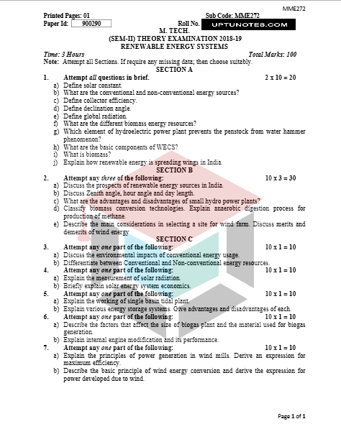
OLD QUESTION PAPER

Slide 82
OLD QUESTION PAPER

Slide 83
References
Energy Efficient Buildings in India Mili Majumdar Tata Energy Research Institute
Understanding Renewable Energy Systems Volker Quaschning
Renewable Energy Systems Simmoes Marcelo Godoy CRC Press
Renewable Energy Resources John Twidell Taylor and Francis
Renewable Energy Sources and Their Environmental Impact Abbasi & Abbasi Prentice Hall of India

